Slide 1

INTRODUCTION TO BEHAVIOURAL FINANCE

Slide 2

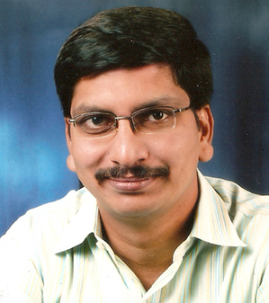
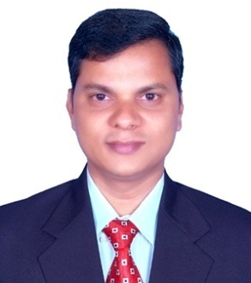

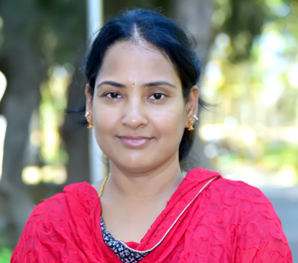
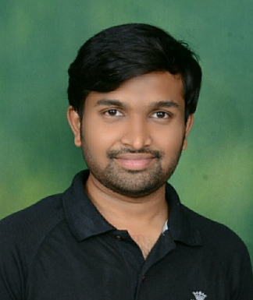
Team Members
Dr G V Sathya Sekhar
Dr GNPV Babu
Dr MV Suryanaraya
Dr. P Aruna
Dr Radha Raghu
Dr R Pavan Kumar Raju

Slide 3

Objective
To understand various theories of human behavior and decision making in financial markets.

Slide 4

Beneficiaries
Financial consultants
Investors
Stock brokers
Management students

Slide 5

Outcome
Students will be able to appreciate the knowledge of human behavior and decision making theories relating to financial markets.

Slide 6

Pedagogy
Three weeks course, consisting of three topics in each week.
Each of the topics will be taken up by eminent faculty of GITAM.

Slide 7
Assessment planned
MCQs and online assignments at the end of each week.
Pass percentage is 50%

